Slide 1
Pertemuan 14
Integral Tentu

Slide 2
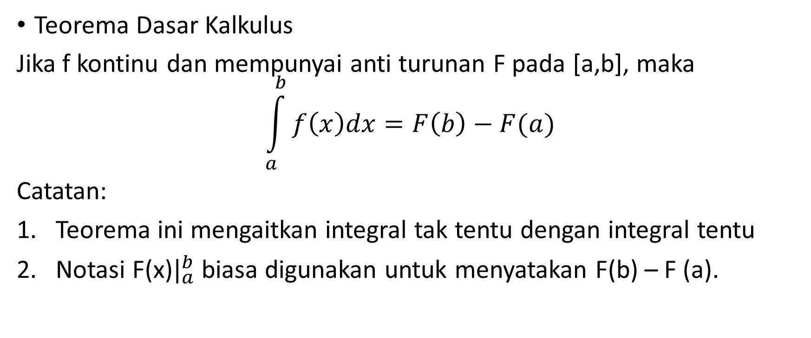
Integral Tentu
Teorema Dasar Kalkulus
Jika f kontinu dan mempunyai anti turunan F pada [a,b], maka
$$\int_{a}^{b}{f\left(x\right)dx=F\left(b\right)−F(a)}$$
Catatan:
Teorema ini mengaitkan integral tak tentu dengan integral tentu
Notasi F(x)$|_{a}^{b}$ biasa digunakan untuk menyatakan F(b) – F (a).

Slide 3
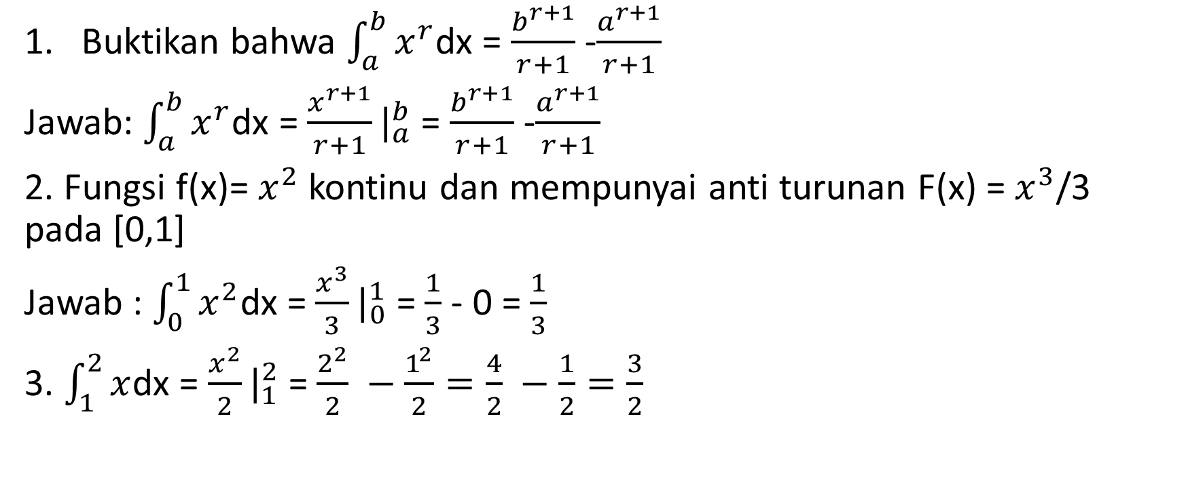
Contoh
Buktikan bahwa $\int_{a}^{b}{x^{r}}$dx = $\frac{b^{r+1}}{r+1}$ -$\frac{a^{r+1}}{r+1}$
Jawab: $\int_{a}^{b}{x^{r}}$dx = $\frac{x^{r+1}}{r+1}|_{a}^{b}$ = $\frac{b^{r+1}}{r+1}$ -$\frac{a^{r+1}}{r+1}$
2. Fungsi f(x)= $x^{2}$ kontinu dan mempunyai anti turunan F(x) = $x^{3}$/3 pada [0,1]
Jawab : $\int_{0}^{1}{x^{2}}$dx = $\frac{x^{3}}{3}|_{0}^{1}$ = $\frac{1}{3}$ - 0 = $\frac{1}{3}$
3. $\int_{1}^{2}{x}$dx = $\frac{x^{2}}{2}|_{1}^{2}$ = $\frac{2^{2}}{2} −\frac{1^{2}}{2}=\frac{4}{2} −\frac{1}{2}=\frac{3}{2}$

Slide 4
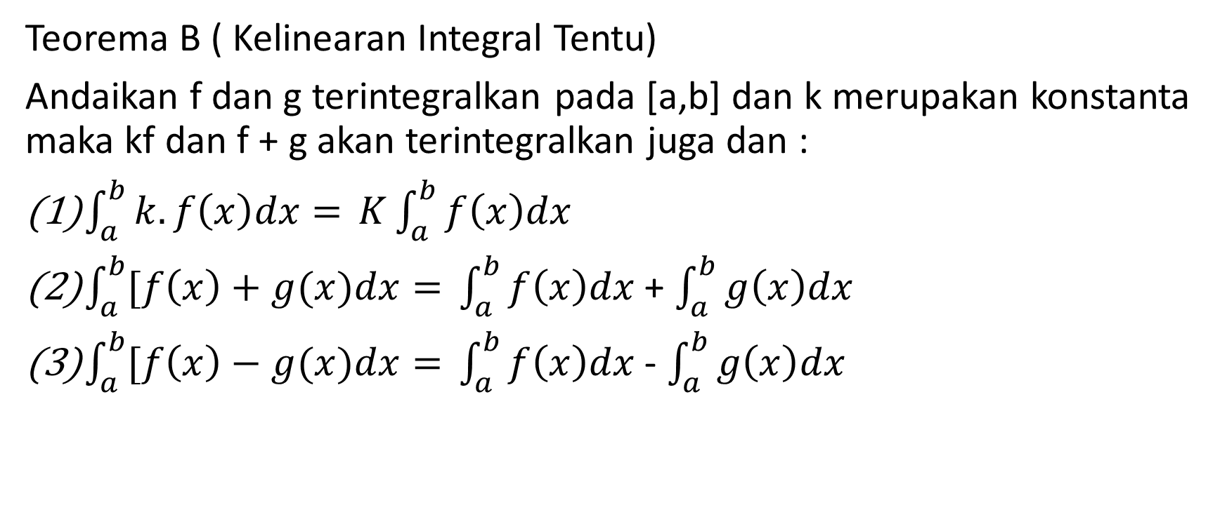
Teorema B ( Kelinearan Integral Tentu)
Andaikan f dan g terintegralkan pada [a,b] dan k merupakan konstanta maka kf dan f + g akan terintegralkan juga dan :
$\int_{a}^{b}{k.f\left(x\right)dx= }K\int_{a}^{b}{f\left(x\right)dx}$
$\int_{a}^{b}{[f\left(x\right)+g(x)dx= }\int_{a}^{b}{f\left(x\right)dx}$ + $\int_{a}^{b}{g\left(x\right)dx}$
$\int_{a}^{b}{[f\left(x\right)−g(x)dx= }\int_{a}^{b}{f\left(x\right)dx}$ - $\int_{a}^{b}{g\left(x\right)dx}$

Slide 5
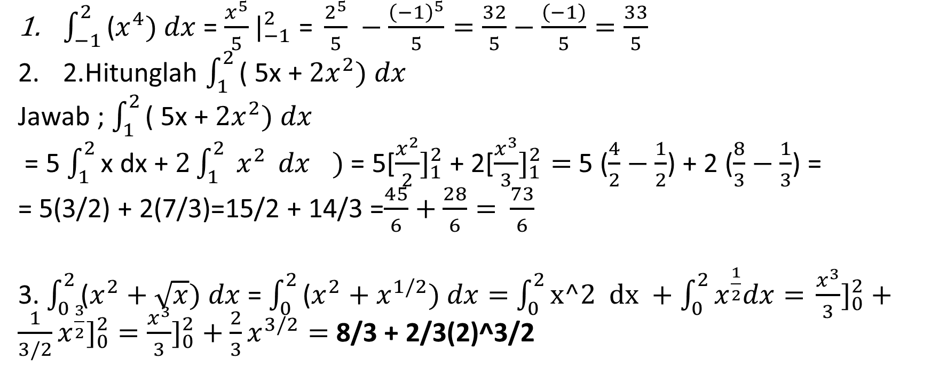
Contoh dengan menggunakan kelinearan integral tentu
$\int_{−1}^{2}{\text{(}x^{4})}$ $dx$ = $\frac{x^{5}}{5}|_{−1}^{2}\text{ = }\frac{2^{5}}{5} −\frac{{\left(−1\right)}^{5}}{5}=\frac{32}{5}−\frac{\left(−1\right)}{5}=\frac{33}{5}$
2.Hitunglah $\int_{1}^{2}{\text{( 5}\text{x}\text{ + }{2x}^{2})}$ $dx$
Jawab ; $\int_{1}^{2}{\text{( 5}\text{x}\text{ + }{2x}^{2})}$ $dx$
= 5 $\int_{1}^{2}{\text{x} \text{dx}\text{ + }{2\int_{1}^{2}{ x^{2}} dx}^{})}$ = 5[$\frac{x^{2}}{2}]_{1}^{2}$ + 2[$\frac{x^{3}}{3}]_{1}^{2}=$5 ($\frac{4}{2}−\frac{1}{2}$) + 2 ($\frac{8}{3}−\frac{1}{3}$) =
= 5(3/2) + 2(7/3)=15/2 + 14/3 =$\frac{45}{6}+\frac{28}{6}=$ $\frac{73}{6}$
3. $\int_{0}^{2}{\text{(}x^{2}+\sqrt{x})}$ $dx$ = $\int_{0}^{2}{\text{(}x^{2}+x^{1/2})}$ $dx=$ $\int_{0}^{2}{\text{x}\text{^2 }\text{dx} +\int_{0}^{2}{x^{\frac{1}{2}}dx= }}\frac{x^{3}}{3}]_{0}^{2}+\frac{1}{3/2}x^{\frac{3}{2}}]_{0}^{2}=\frac{x^{3}}{3}]_{0}^{2}+\frac{2}{3}x^{3/2}=$ 8/3 + 2/3(2)^3/2

Slide 6
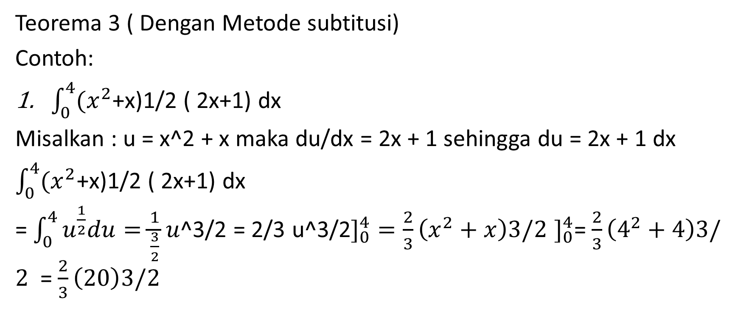
Teorema 3 ( Dengan Metode subtitusi)
Contoh:
$\int_{0}^{4}{{(x}^{2}}$+x)1/2 ( 2x+1) dx
Misalkan : u = x^2 + x maka du/dx = 2x + 1 sehingga du = 2x + 1 dx
$\int_{0}^{4}{{(x}^{2}}$+x)1/2 ( 2x+1) dx
= $\int_{0}^{4}{u^{\frac{1}{2}}du=\frac{1}{\frac{3}{2}}u}$^3/2 = 2/3 u^3/2$]_{0}^{4}=\frac{2}{3}\left(x^{2}+x\right)3/2$ $]_{0}^{4}$= $\frac{2}{3}\left(4^{2}+4\right)3/2$ = $\frac{2}{3}\left(20\right)3/2$

Slide 7

Latihan!!!!
$\int_{0}^{2}{x^{3}}$ $dx$=
$\int_{−1}^{2}{{(3x}^{3}−2x+3)}$ $dx$ =
$\int_{1}^{4}{(\frac{2}{{5w}^{2}})}$ $dw$
$\int_{−4}^{−2}{( y^{3}+\frac{1}{y^{3}})}$ $dy$
$\int_{1}^{8}{\sqrt[3]{w}}$ $dw$
$\int_{0}^{3}{(x \sqrt{x^{2}+1}})$ $dx$
$\int_{0}^{1}{({x^{2}+1)}^{10}(2x })$ $dx$

